Slide 1
Movie Recommendation System
Yan Gu
Xinyang Wang
Notes:
We are group 26, the topic we choose is…

Slide 2
Target:
Build a recommendation system that can recommend movies for people, according to the movies and corresponding ratings they provide.

Slide 3
Data source: Movielens 1M Dataset
Link: https://grouplens.org/datasets/movielens/
Content: 1 million ratings from 6000 users on 4000 movies
Files: movies.dat
ratings.dat
users.dat
Notes:
The data we use to do experiments and to draw conclusion from in this project is MovieLens 1Mega Dataset . You can access it through the following link. The data contains 1 million ratings from 6000 users on 4000 movies and are separated into three files: …

Slide 4
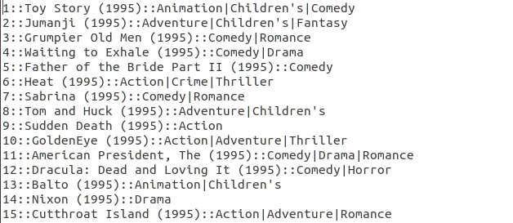
Data formats:
movies.dat: MovieID::Title::Genres
Notes:
In movies.dat file, we got the following data format: …
We can have a look at the sreenshot of the the data in this file. 可以念一下第一行数据
冒号 colon
一部电影Genres可以有多个

Slide 5
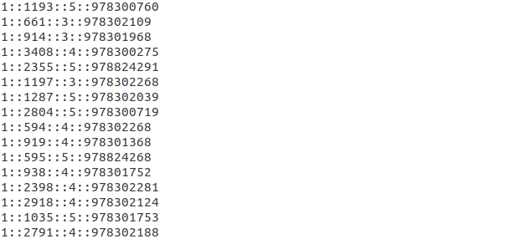
Data formats:
ratings.dat: UserID::MovieID::Rating::Timestamp
Notes:
In ratings.dat file, the data format is …
We can also have a look at the screen of the data in this file, 念一下第一行数据
Timestamp not been used because it is just the length of a movie and we think it is not related to rating and other features.
UserIDs range between 1 and 6040
MovieIDs range between 1 and 3952
Ratings are made on a 5-star scale (whole-star ratings only)
Timestamp is represented in seconds since the epoch as returned by time(2)
Each user has at least 20 ratings

Slide 6
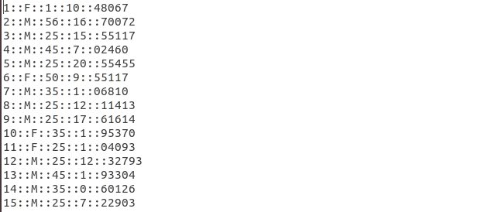
Data formats:
users.dat: UserID::Gender::Age::Occupation::Zip-code
Notes:
Age is chosen from the following ranges:
* 1: "Under 18"
* 18: "18-24"
* 25: "25-34"
* 35: "35-44"
* 45: "45-49"
* 50: "50-55"
* 56: "56+“
For example, occupation is :
0: "other" or not specified
1: "academic/educator“
16: "self-employed"

Slide 7
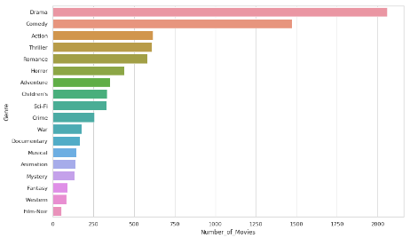
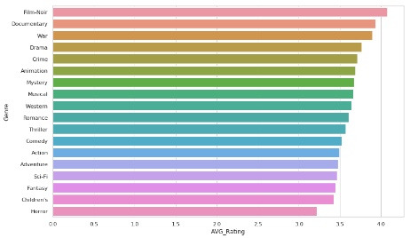
Number of movies rated for each genre & average ratings
Notes:
The following pages show some interesting results we get from the original data.
From the left chart We can see that Film-Noir is the least popular, （Film-Noir is a cinematic term used primarily to describe stylish Hollywood crime dramas, particularly those dramas that emphasize cynical attitudes and sexual motivations.） but from the right chart we can see its average rating is the highest. This is reasonable in fact. Because Film-Noir is not popular, people who watch them must be fond of this type, therefore they are very likely to give high ratings
/nwa：/

Slide 8
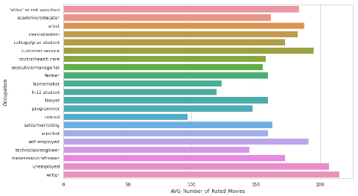
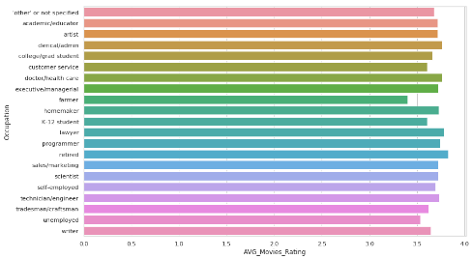
Number of movies rated & average ratings according to careers
Notes:
This page shows number of movies rated according to careers and average ratings according to careers .
From the left chart, we can see that writers watch the most movies. It is possible that writers want to get inspiration through movies. As we know, novels and movies are tightly connected. Many novel are shot into movies.
From the second chart, we can see retired people tend to give high ratings. That also comply with reality. elder people are usually tolerant, even of a bad movie.

Slide 9
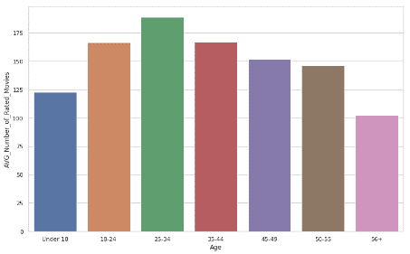
Number of movies rated according to age distribution
Notes:
This page shows Numbers of movies rated according to age distribution
As we can see， people aged from 25 to 34 rate the most movies compared to other age groups. For people at older age groups, the number of movies rated decreases as the age of people increases. This maybe because on the one hand, older people are not as interested in fashion stuff like movies as younger people do, on the other hand, younger people prefer to express their ideas and feelings on the internet

Slide 10
The next step:
Collaborative Filtering: a very efficient algorithm in recommendation field
User-based Collaborative Filtering
Item-based Collaborative Filtering
Notes:
Above steps are drawn by using spark. And now we are trying to implement collaborative filtering. It is a very efficient algorithm in recommendation field. It has two basic ways. The first is… the second is…

Slide 11
Item-based Collaborative Filtering:
one time computation of the similarity matrix
More rational as to the recommendation results.
Notes:
After research, we decided to use Item-based Collaborative Filtering. Because it has the following advantages compared to user-based Collaborative Filtering.
First We just need to compute the similarity matrix for one time. If we use user-based…, we need to recompute similarity matrix when a new user come in， which will cost huge amount of time.
Another advantage is that item… is more rational as to the recommendation results. let’s say a person is a fan of action movies, then item-based CF will most probably recommend action movies to this person. While in user-based CF, the recommendation results may be other kinds of movies.
Most widely used model, field-independent and no need strict math modeling and is portable for many problems.
Open recommendation and can use training data as something like “experience “ to dig into potential interest for new users.

Slide 12
Thank you
Notes:
This is the end of our representation. Thank you for your time.

